Slide 1
c₂ filters
∗
…
H
c₁
ReLU
c₁
h₁
H2
c₂
W
w₁
H
W2
W

Slide 2
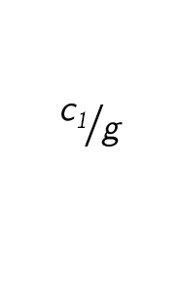
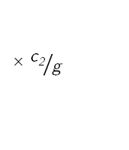
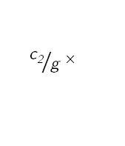
c₂ filters
×${ \text{c}\text{2}}/{\text{g} }$
∗
H
${ \text{c}\text{2}}/{\text{g} }$×
ReLU
c₁
h₁
$${\text{c}\text{1}}/{\text{g} }$$
H2
c₂
W
w₁
H
W2
W

Slide 3
d filters
∗
H
H
…
W
W
c
d
c
1
1

Slide 4
c₂ filters
c₃ filters
∗
…
∗
H
c₁
…
H
c₁
ReLU
H2
c₂
c₂
ReLU
W
c₃
W
h₁
w₁
H
W2
W
1
1

Slide 5
c₂ filters
×${ \text{c}\text{2}}/{\text{g} }$
c₃ filters
∗
∗
H
${ \text{c}\text{2}}/{\text{g} }$×
…
H
c₁
ReLU
H2
c₂
c₂
ReLU
W
c₃
W
h₁
w₁
$${\text{c}\text{1}}/{\text{g} }$$
H
W2
W
1
1

Slide 6
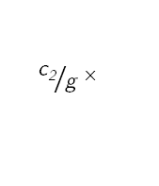
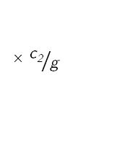
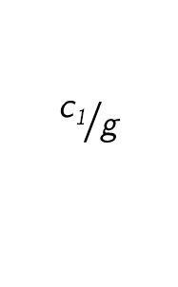
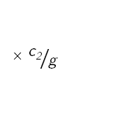
c₂ filters
×${ \text{c}\text{2}}/{\text{g} }$
c₃ filters
×${ \text{c}\text{2}}/{\text{g} }$
∗
∗
H
${ \text{c}\text{2}}/{\text{g} }$×
…
H
c₁
ReLU
H2
c₂
c₂
ReLU
W
c₃
W
H
W2
${ \text{c}\text{2}}/{\text{g} }$×
W
h₁
1
w₁
$${\text{c}\text{1}}/{\text{g} }$$
1

Slide 7
∗
…
H
ReLU
W
H2
3
W2
Input Image

Slide 8
∗
…
∗
…
ReLU
H2
ReLU
W2
1
1

Slide 9
∗
…
ReLU
H2
W2

Slide 10
∗
…
∗
…
ReLU
H2
ReLU
W2
1
1

Slide 11
∗
∗
…
ReLU
H2
ReLU
W2
1
1
Root-2 Unit

Slide 12
∗
∗
…
ReLU
H2
ReLU
W2
1
1
Root-4 Unit

Slide 13
∗
…
∗
…
ReLU
H2
ReLU
Convolutional Layer
W2
1
1

Slide 14
…
∗
ReLU

Slide 15
∗
…
H
ReLU
W
3

Slide 16
∗
…
ReLU

Slide 17

…
ReLU
1
1

Slide 18
∗
ReLU

Slide 19
∗
ReLU

Slide 20
…
∗
ReLU

Slide 21
∗
…
ReLU
1
1

Slide 22
∗
…
ReLU
1
1

